Slide 1
Get Going on Jam – via RBP

Slide 2
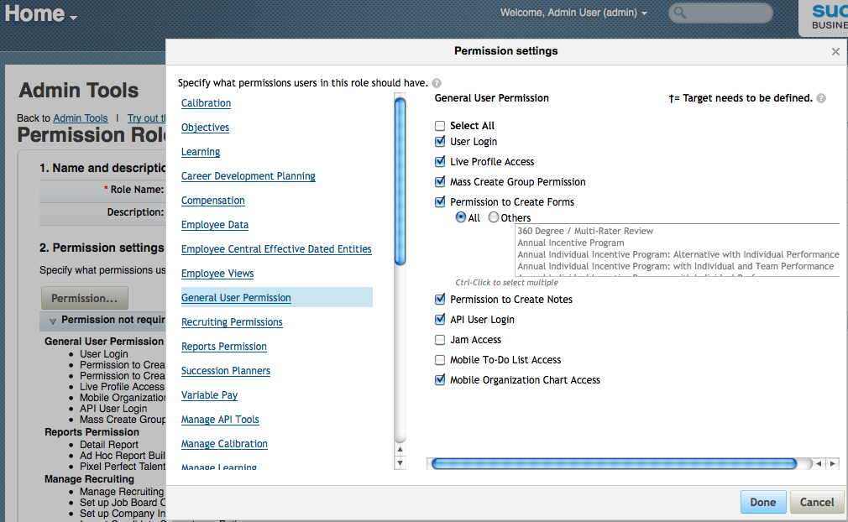
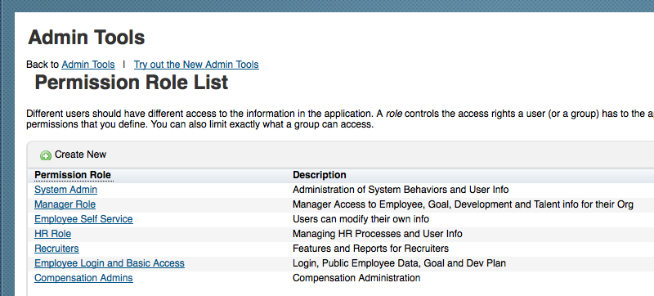
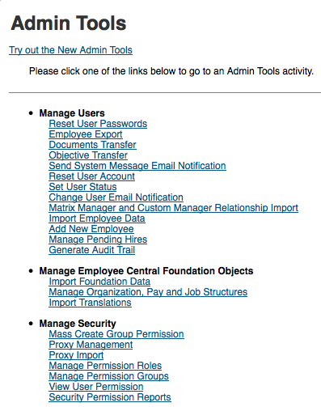
Enabling Jam via Role Based Permissions

Slide 3
RBP – Jam Access

