Slide 1
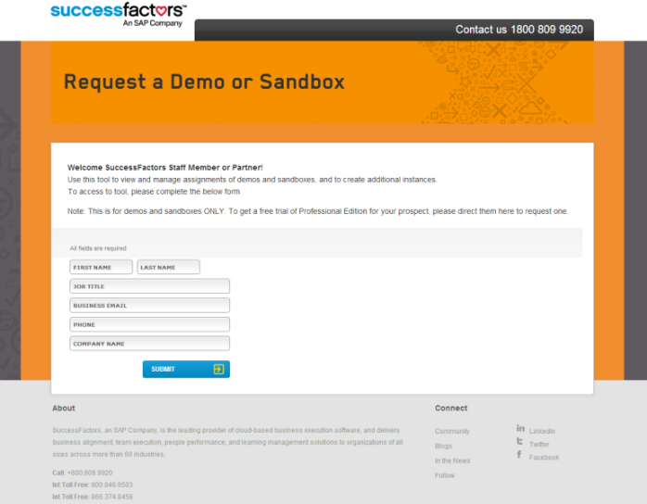
Live Demos: Demo Access & Support
Please refer to demo request user guide:
SAP Jam Partner Enablement > Content > Demos > Demo Request User Guide
You need to be a PartnerEdge partner and ask your Partner Manager / SAP Partner Service Advisor for help to get onboarded to be able to request the demo system
Remark: For SAP employees the process is different: Please create an IT-Direct Ticket with the component IMFIT_SE to request a demo system or create a DBR, demo build request, to ask for integrations needed
Tipps & Tricks
Ask your PSA or internal demo champion for help
Integrate your system with other demo systems. In case you´d like to integrate your system select data center 8 (instead of data center 4).
Select ACE which is the ACE Corp. demo company with great demo data and Bestrun.
Prerequisite
available for SAP PartnerEdge Partners that signed a Cloud Addendum
SAP Jam Academy as well as Introduction Academy completed THR80 and THR90 trainings can be booked here: http://training.sap.com enter “SAP Jam” in search field)
eLearnings completed. They can be found under > PartnerEdge > all products > SAP Jam or in SAP Jam Partner Enablement > Content > Demos > SAP Jam Partner Enablement Brief
Remark
You need a demo system SuccessFactos including Jam instance, in some few cases the Jam instance wasn´t created within a working day. In these cases please request support using the SuccessFactors Partner Portal, https://partners.successfactors.com/Pages/Partner-Portal-Home.aspx

