Slide 1
Role Based Security
Paul Littlefield
Product Management
2011-08-31
Notes:
This is a presentation on SuccessFactors roadmap plans for role based security.
This presentation contains both a conceptual model and mockups of the user interface to communicate how the new system will work.

Slide 2
What is the Role Based Security Enhancement?
This is a new system for managing permissions
Contains significant enhancements to ease administrative burdens of large enterprises
Will require significant configuration and testing to migrate existing customers
The new system is optional. You can continue to use the current permission framework.

Slide 3
Don’t we have roles already?
We have many roles today
Manager, HR Manager, Matrix Manager, Custom Manager, Second Manager, Recruiting Roles, Other Roles
Problems
Large enterprises want even more roles
Want more automation around permissions assigned to roles
(Detailed Reporting Rights, Succession Planning Permission, Form Creation, etc)
Hard to understand all the permissions assigned to a role
Want more power for Live Profile fields permissions

Slide 4
Benefits
More roles
Automates role assignment to users
Easier to understand all the permissions assigned to a role
More options for identifying how users are assigned to roles

Slide 5
Role Based Security Goals
Increase administrative efficiency
Satisfy complex security control models
Handle security requirements of large enterprises and conglomerates
Notes:
While our current system has many powerful and scalable features to manage security today, there are improvements that are needed to increase the administrative efficiency and also increase the functional capabilities, especially in large organizations.

Slide 6
What Permissions are Included?
In Scope
Permissions Managed in Admin Tools
Live Profile (Data Model) Permissions
Not In Scope
Permissions Defined in Templates
Performance Management Form Template Permissions
Goal Plan Template Permissions
CDP Template Permissions
Recruiting Template Permissions
Notes:
Scope clarifications. This framework is aimed at the current security administration tasks required in Admin Tools. It is not aimed at the security configurations defined in templates. The template security settings are a different security configuration that is setup by professional services at configuration time.

Slide 7
Migrating Path for Existing Customers
No automated migration, this is a new configuration. The current permissions system does not translate to the new system
Requires Professional Services configuration and testing effort, with SOW and PS Charges
Tools
View current security configuration
View and audit changes to the new role based security configuration
Copy configuration from your test system to your production system

Slide 8
Role Based Security Concepts
Granted
Users
Target
Users
Role
The role defines access to data and functionality
Roles are granted to groups of users (left circle)
Granted users may perform the role on target users (right circle)
Groups can be dynamic to automate assignment of permissions
Administrators can define many roles
Notes:
This diagram is a conceptual module for role based security in SuccessFactors.
In this diagram is a role, represent by the green box, and groups of users represented by the two yellow circles.
The role defines access to data and functionality. This is where you define what you want your role to do in SuccessFactors. For example, should the role be allowed to view dashboards?
Once the role is defined, you grant the role to groups of users represented by the left circle.
Lastly you restrict the granted users to perform the role on target users. For example, you may decide that managers (the left circle) can view dashboards (defined in the role) on their team (the right circle). I will go into more detail on this later.
Groups can be dynamic which allows us to automate the assignment of permissions. For example, a group of granted users can be “All employees in the Sales department”. As employees are transferred into and out of the sales department, their permissions with automatically adjust.
Administrators can define many roles.

Slide 9
Role Based Security Concepts
Example
Role Name: HR Role
Permissions:
View performance ratings information
Edit potential ratings information
Create performance review form
Granted Users
Permission Role
Target Users
USA
HR
USA
Employees
HR Role
DEU
HR
DEU
Employees
HR Role
Notes:
This example shows a scenario where an HR Role definition is shared and granted to different user with different target groups.
In the first row, people in the HR department in the US can perform the HR Role on all employees in the US.
In the second row, people in the HR department in Germany can perform the HR Role on all employees in Germany.

Slide 10
Role Based Security Concepts
Example
Role Name: Manager Role
Permissions:
View salary information
Edit address information
Granted Users
Permission Role
Target Users
USA
Managers
Team,
All Levels
Manager Role
DEU
Managers
Team,
2 Levels
Manager Role
Notes:
Here is another example to demonstrate that target users can be defined through the employee heirarchy (Team = direct reports).
In the first row, Managers in the USA can perform the Manager Role on their Team, all levels deep.
In the second row, Managers in Germany can perform the Manager role on their Team, but only two levels deep (two levels restriction in hierarchies is common in EMEA).

Slide 11
Setup Process
Step 1: Create the groups
Step 2: Create the role
Step 3: Grant the role (link role to groups)
Granted Users
Permission Role
Target Users
USA
HR
USA
Employees
HR Role
DEU
HR
DEU
Employees
HR Role
Notes:
There are three steps to setting up permissions in this new framework.
1. Create the groups – define the groups you want to grant and target
2. Create the role – define the role. What data can the role access (live profile data - fields and background sections)? What actions can the role perform (actions like create performance review form, or perform succession planning)?
3. Grant the role. Link the Green Box to the Yellow Circles.
Now we will There are three steps to setting up permissions in this new framework.
1. Create the groups – define the groups you want to grant and target
2. Create the role – define the role. What data can the role access (live profile data - fields and background sections)? What actions can the role perform (actions like create performance review form, or perform succession planning)?
3. Grant the role. Link the Green Box to the Yellow Circles.
Now we will show you how to create four groups that represent the four Yellow Circles shown above.

Slide 12
Demo Time: Show the mockups
Step 1: Create the groups
Step 2: Create the role
Step 3: Grant the role (link role to groups)
Granted Users
Permission Role
Target Users
USA
HR
USA
Employees
HR Role
DEU
HR
DEU
Employees
HR Role
Notes:
Prototype Demo: Show how the product works.

Slide 13
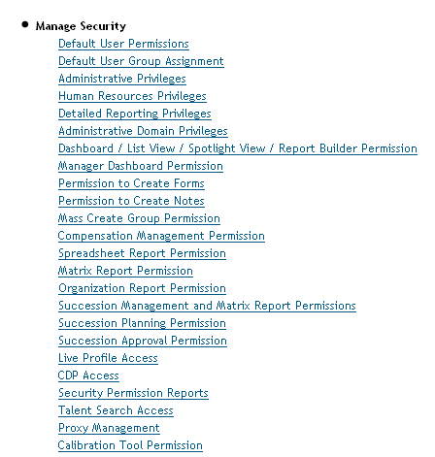
Manage Permission Groups
Managing Security
The Current Way
Managing Security The New Way
Notes:
Now lets dive into the application solution. How will this new framework look and appear to you?
On the left is a list of links in our current solution that largely control the administration of security in our admin tools pages.
On the right is a new list of links that will be the new gateway to managing security.
The first step in managing security is to create permission groups. These are the yellow circles from the conceptual diagram. Select the “Manage Permission Groups” link.

Slide 14
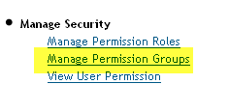
Manage Permission Groups
Managing Security
The Current Way
Managing Security The New Way

Slide 15
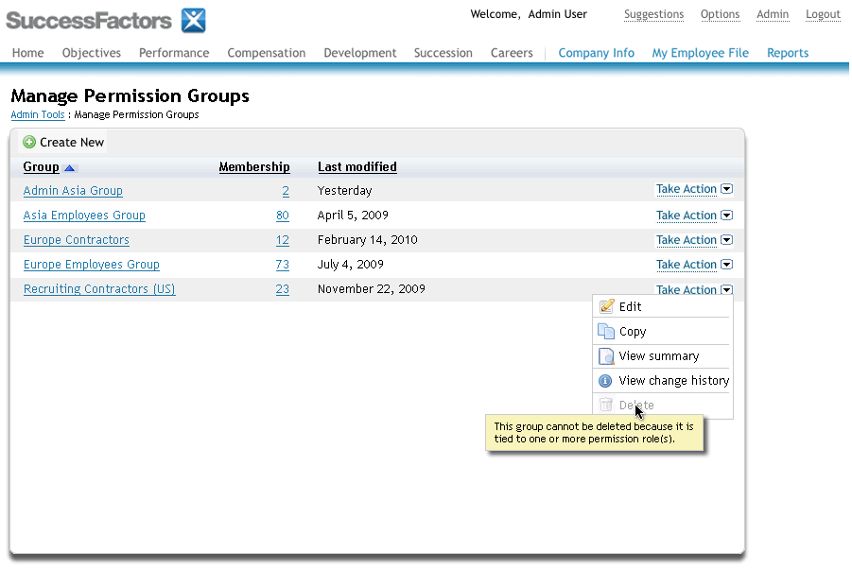
Managing Permission Groups
Create New Group
Notes:
This will bring up the Manage Permission Groups page. A permission group is a group of users that you can define and use to grant permissions to in the Role Based Security framework. Here we can see existing groups that were created. You can edit, copy and delete these groups, or create new ones.
New groups are created by selecting the “Create New” button at the top left of the screen.

Slide 16
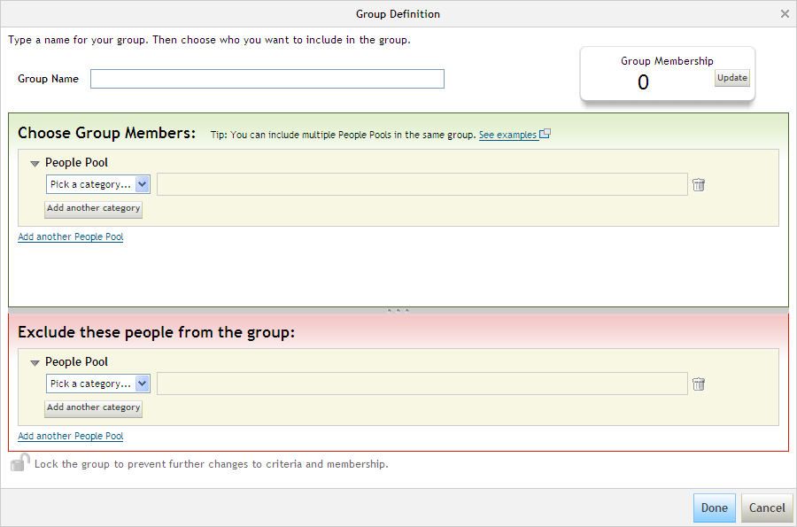
Groups Definition Tool
Notes:
This is the groups definition tool. Here you define your groups by specifying criteria.
Overview of this page:
Group Name
Chose Group Members (green box)
Exclude people from the group (red box)
Group Membership count – top right

Slide 17
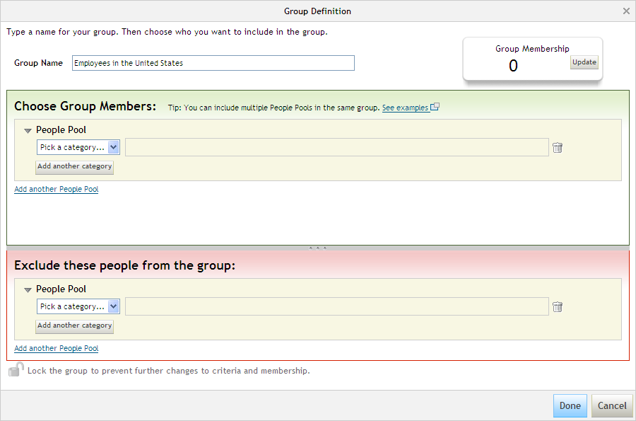
Create Group Employees in the US
Notes:
Enter a name for your group

Slide 18
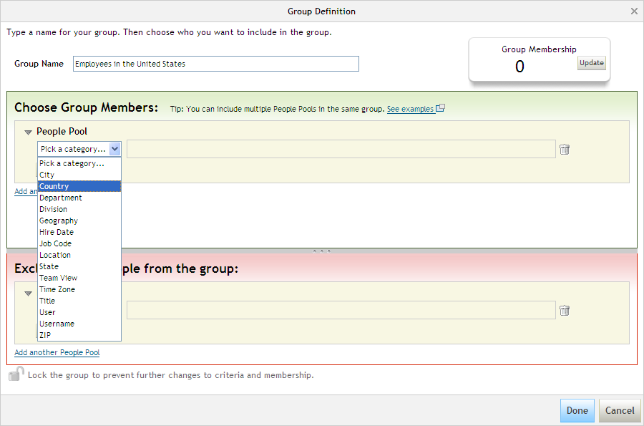
Create Group “Employees in the US”
Notes:
Selecting the dropdown to pick a filter category, and select the “Country” category

Slide 19
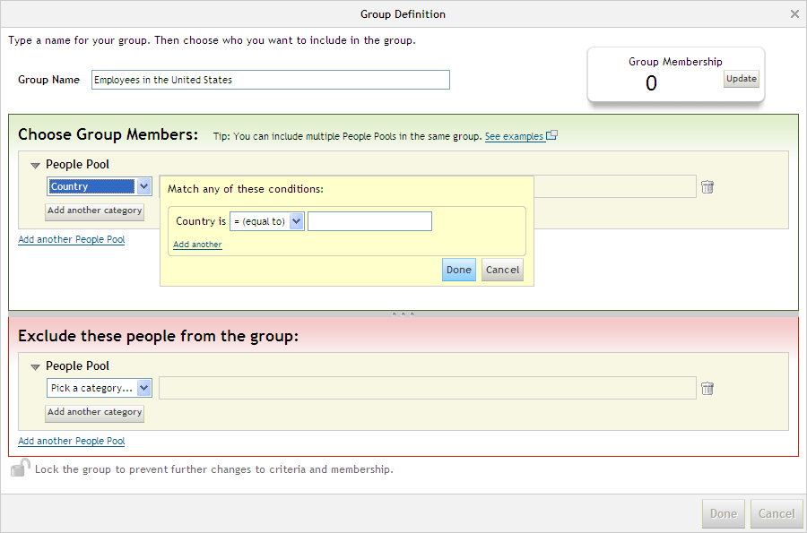
Create Group “Employees in the US”
Notes:
This brings up a text entry. Start typing in “United States”

Slide 20
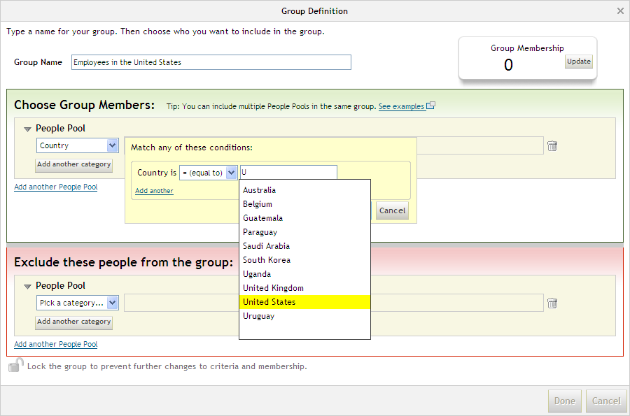
Create Group “Employees in the US”
Notes:
This widget will auto filter against existing values in your system. You can select from the results, or continue typing to refine the selection.

Slide 21
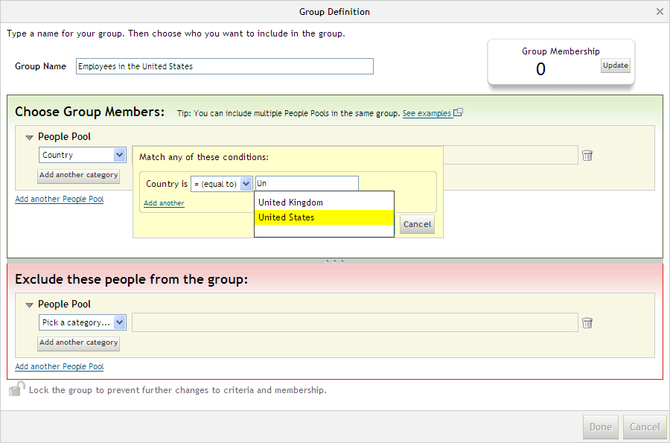
Create Group “Employees in the US”
Notes:
Select “United States”

Slide 22
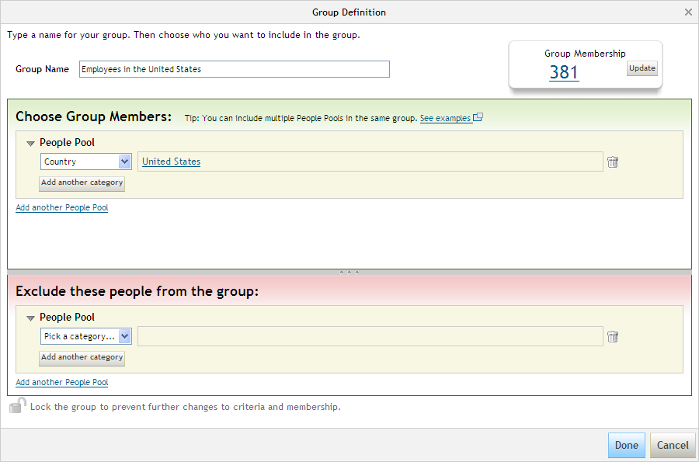
Create Group “Employees in the US”
Select “Done”
to save the group
Notes:
The selection is displayed, and you can get a count of the “Group Membership” by selecting the “Update” button. Save the group by selecting the “Done” button.

Slide 23
Done Create Group “Employees in the US”
Create New Group
Notes:
This will return us to the Permission Groups page where you will see your new group.
Now create the group “Human Resources in the US”.

Slide 24
Create Group “Human Resources in the US”
Notes:
Create the other three groups

Slide 25
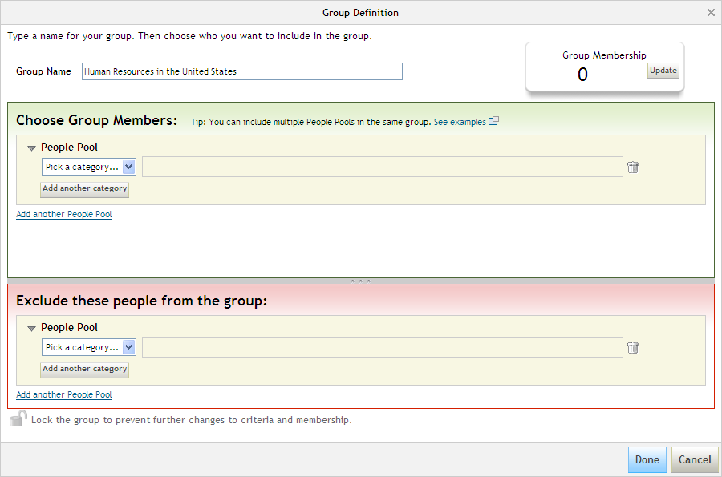
Groups Definition Tool – Pick a Category
Notes:
Selecting the dropdown to pick a filter category, this time pick Department

Slide 26
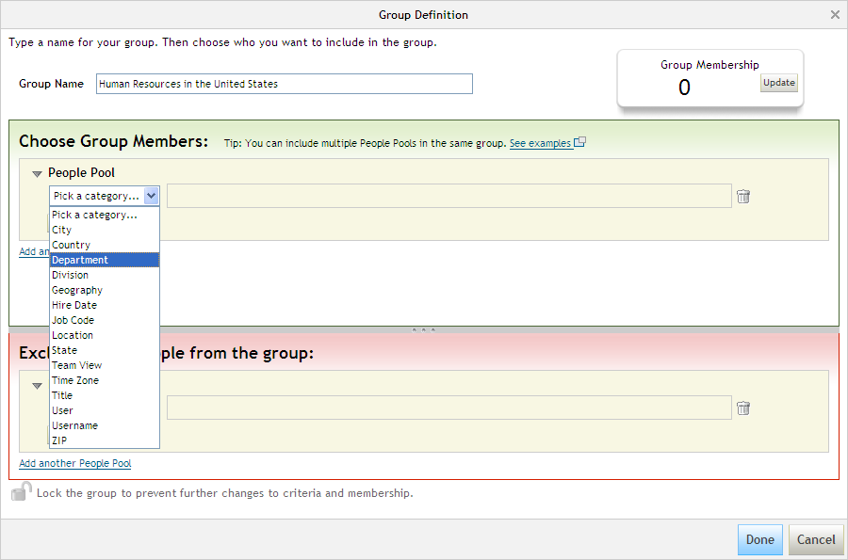
Groups Definition Tool – Pick a Category
Notes:
Select the “Department” category

Slide 27
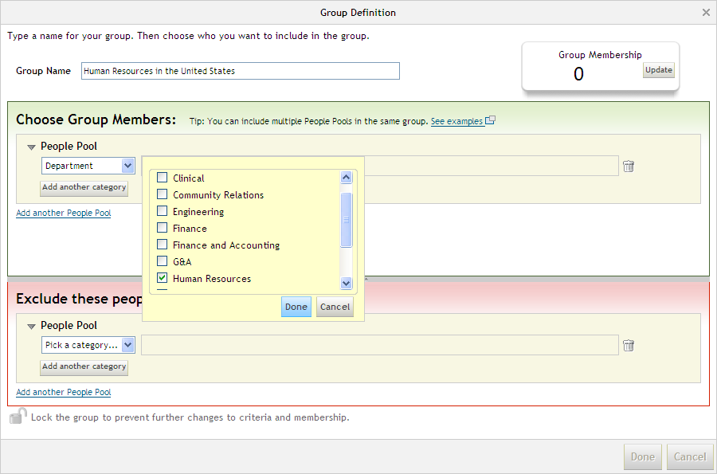
Group Definition Tool
Select
“Human Resources”
Select
“Done”
Notes:
We have selected the “Department” category. This will present a list of values for departments in your organization. The user interface will adjust for both small and large data sets appropriately (example, 50 departments will get one view as shown here, where 10,000 departments would get a different user interface).

Slide 28
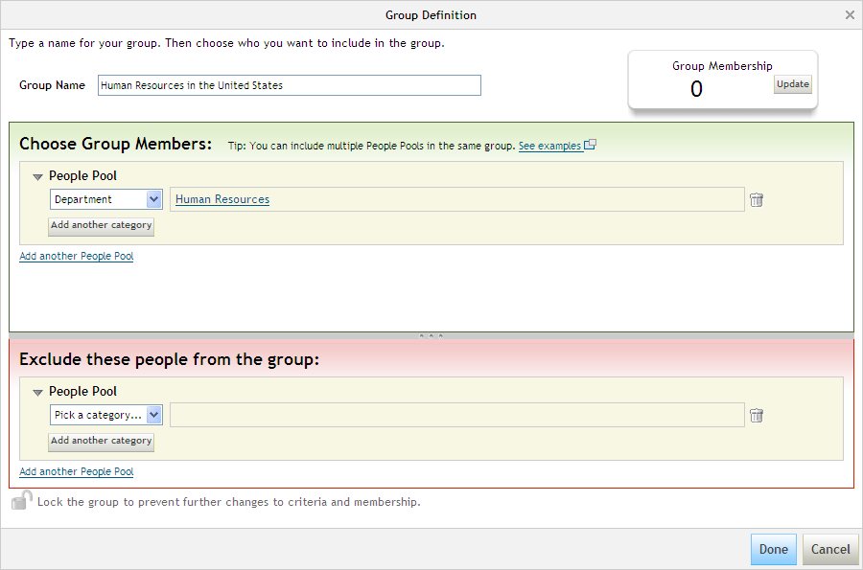
Group Definition Tool
Add another category
Notes:
Show Dept=Human Resources has been selected

Slide 29
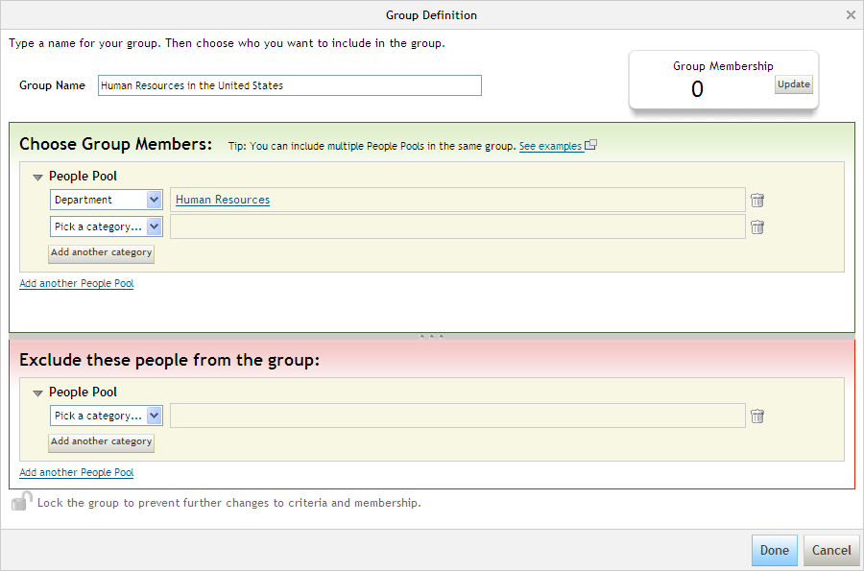
Group Definition Tool
Notes:
Another category filter appears. Select the dropdown for this new filter.

Slide 30
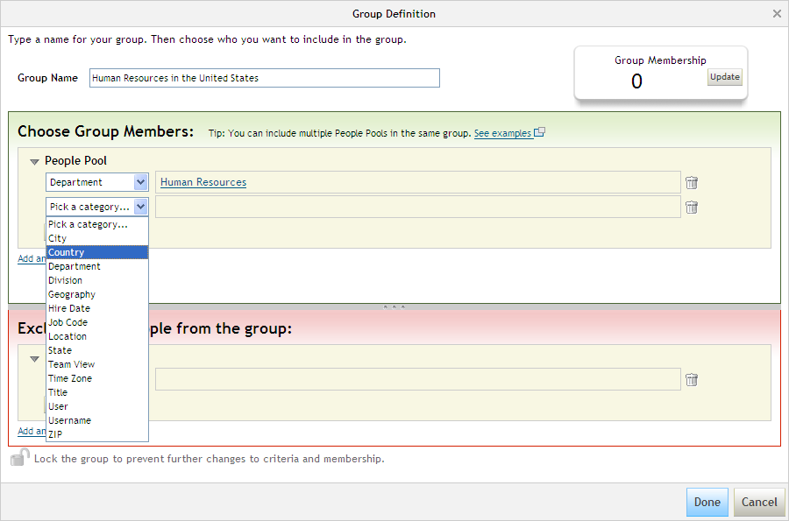
Group Definition Tool
Notes:
Select the “Country” filter value.

Slide 31
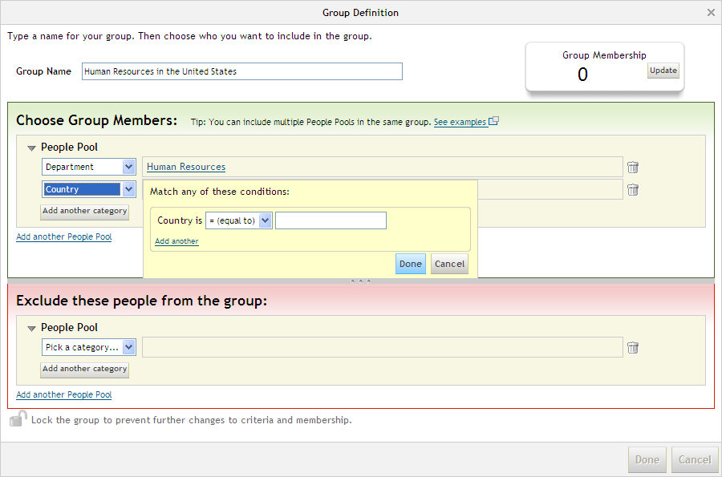
Group Definition Tool
Notes:
As seen previously, this presents a text box that is auto-complete enabled. This will filter against existing Country values in your company. Start typing in “United States”.

Slide 32
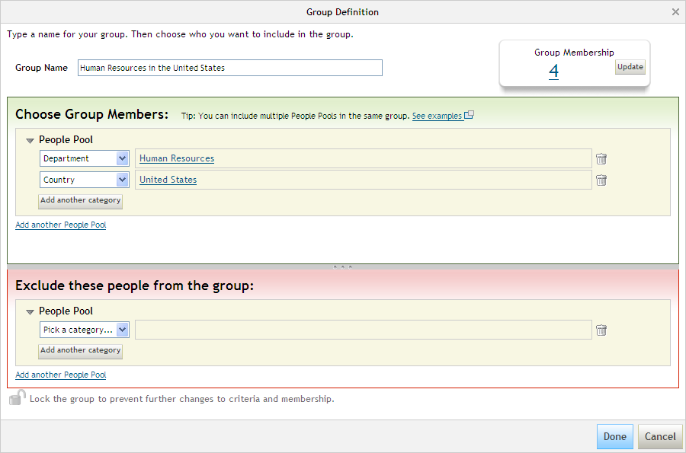
Group Definition Tool
Notes:
Assume we have selected “United States” for the country. Select the “Update” button to view the Group Membership count.

Slide 33
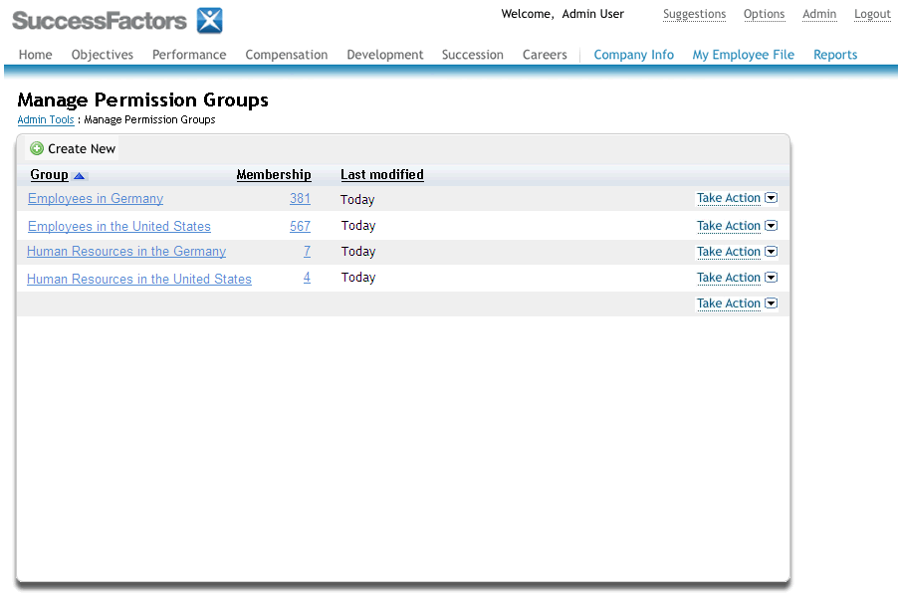
Step One Done: Groups are Created
Granted Users
Permission Role
Target Users
USA
HR
USA
Employees
HR Role
DEU
HR
DEU
Employees
HR Role
Notes:
This will return us to the Permission Groups page where you will see your new group.
We have demonstrated the creation of two groups.
Assume we have followed the same process to create all four groups (the yellow circles)

Slide 34
How it works
Step 1: Create the groups DONE
Step 2: Create the role
Step 3: Grant the role
Granted Users
Permission Role
Target Users
USA
HR
USA
Employees
HR Role
DEU
HR
DEU
Employees
HR Role
Notes:
Step 1 is now done (we have created all four groups in the yellow circles)
Now for Step 2: Create the role

Slide 35
How it Works
Managing Security
The Current Way
Managing Security The New Way
Notes:
Creating roles is done through the “Manage Permission Roles” link.

Slide 36
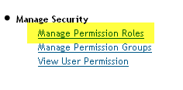
Manage Permission Roles
Managing Security
The Current Way
Managing Security The New Way
Notes:
Select the link “Manage Permission Roles”

Slide 37
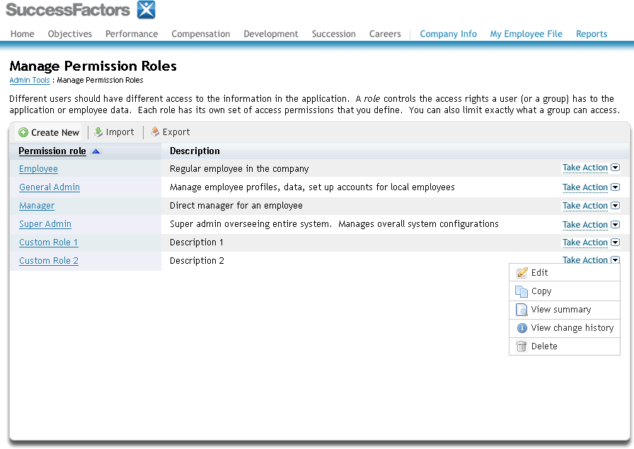
Managing Roles
Create New Role
Notes:
This will bring up the managing roles page.
Here you will see a list of all the roles you have created in your system.
You will be able to create, edit, copy, delete, import and export roles from this screen, as well as view the change history of the role for auditing purposes.
Change history will show all the edits to the role, by person and date.
Creating a role is accomplished by selecting the Create New button, which will bring up the following page

Slide 38
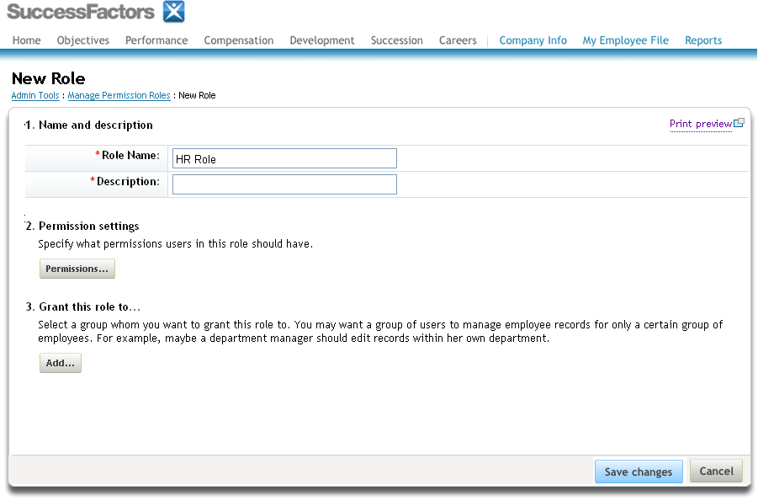
Create New Role
Set Permissions
Notes:
Creating a role has three steps
Crate a name and description.
Set the permissions for the role.
Grant the role to users.
Selecting step 2 (“Permissions” button) brings up the permissions settings page.

Slide 39
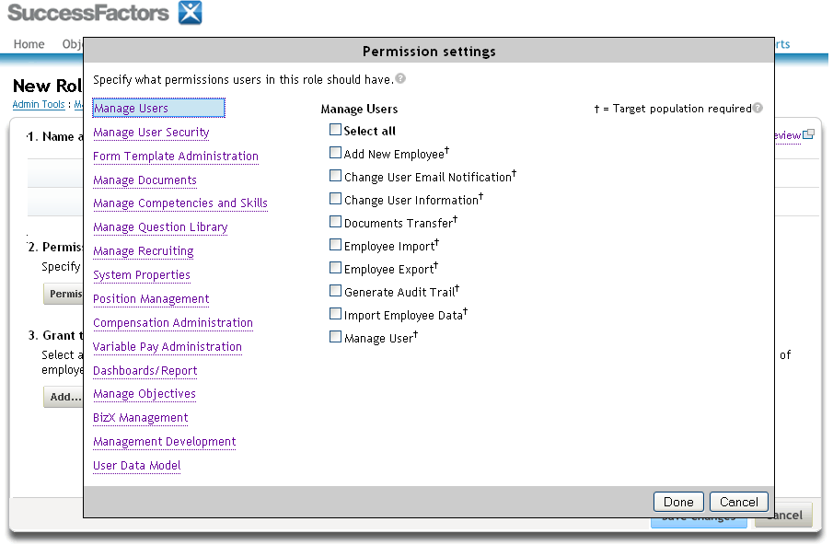
Setting Permissions for the Role
Notes:
Here is where you define all the permissions you would like to enable for this role.
Permissions are organized into categories shown as links on the left side.
In this page, the first category “Manage Users” is selected. This category is a set of administrative permissions that allow the role to perform tasks like “Import Employee Data” or “Change User Information”.

Slide 40
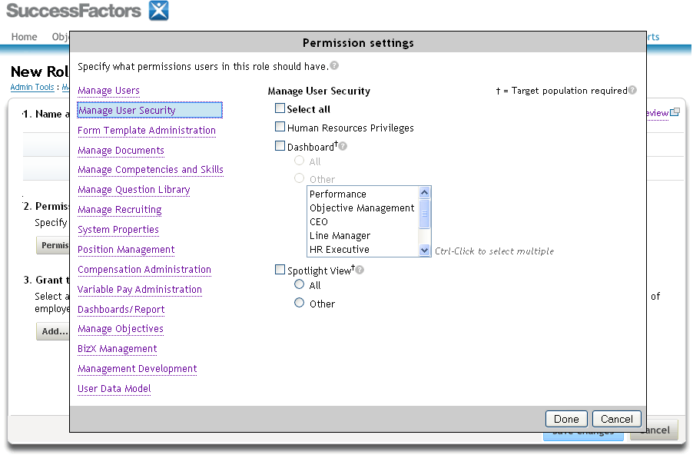
Setting Permissions for the Role
Notes:
The “Manage User Security” link will show permissions that are typically assigned to more than administrative-only roles, and include functionality like the ability to view Dashboards or Spotlight Views.
These mockups are not a final list of all permissions and categories. These mocukps are intended only to represent product concepts and flow. There will be more permissions than are shown under this and other categories, and there may be more categories upon release than are shown in this mockup.
The actual details of the permissions are captured in a separate product requirements document.

Slide 41
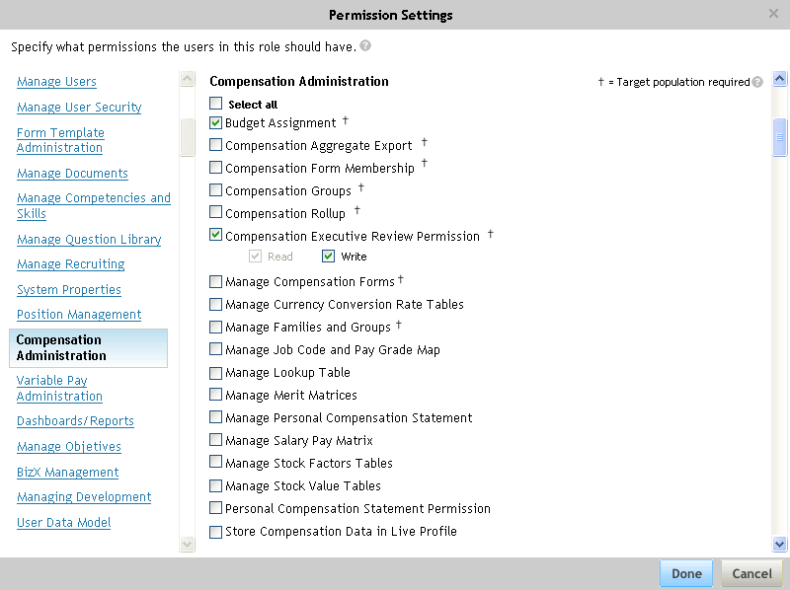
Setting Permissions for the Role
Notes:
Here’s an example of Compensation Permissions

Slide 42
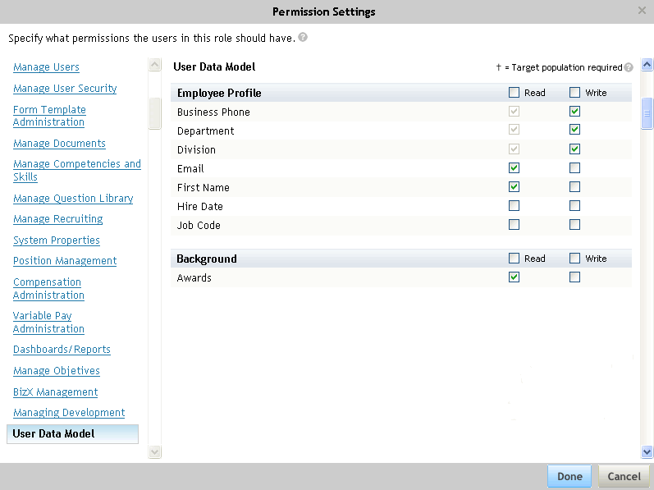
Setting Permissions for the Role
Notes:
A big enhancement in this framework will be the
User Data Model Permissions – setting field and object level access to Live Profile standard elements and background information.

Slide 43
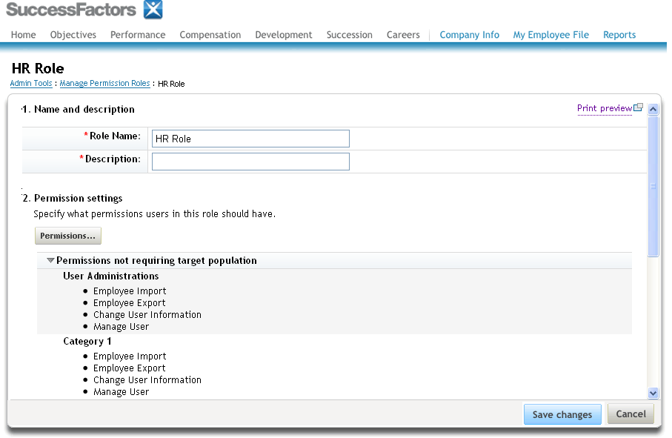
Summary of Permission Selections
The permissions
you selected are summarized here
Notes:
Permissions Summary Screen

Slide 44
How it works
Step 1: Create the groups DONE
Step 2: Create the role DONE
Step 3: Grant the role
Granted Users
Permission Role
Target Users
USA
HR
USA
Employees
HR Role
DEU
HR
DEU
Employees
HR Role
Notes:
Step 1 and 2 are now done. On to step 3 – grant the role to users (link the green box to the yellow circles).

Slide 45
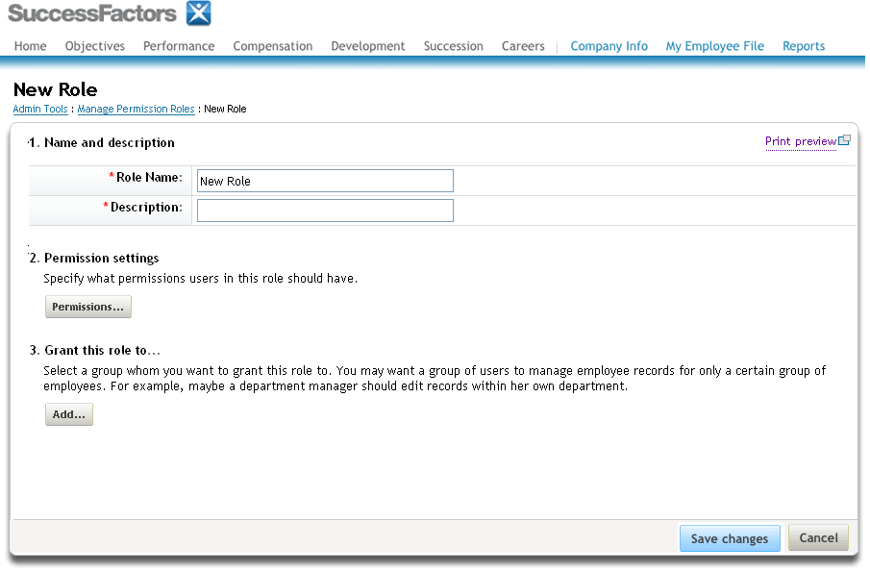
Granting Role to Users
Grant the Role
Notes:
Granting the role is accomplished in the role page in step 3. Here you can grant roles by selecting the “Add..” button.

Slide 46
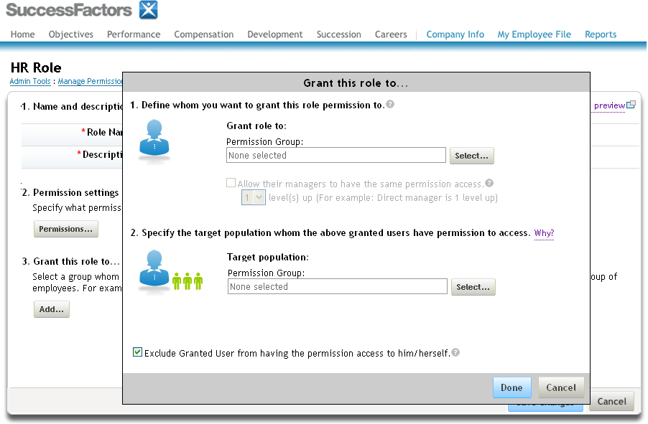
Granting Role to Users
Notes:
This will bring up the Grant role dialog
In step 1 you select your access groups.
In step 2 you select your target groups.

Slide 47
Granting Role to Users
Granted
Users
Target
Users
Manager Role
Notes:
This will bring up the Grant role dialog
In step 1 you select your access groups.
In step 2 you select your target groups.

Slide 48
Granting Role to Users
Select Groups to Grant Role
Notes:
This will bring up the Grant role dialog
In step 1 you select your access groups.
In step 2 you select your target groups.

Slide 49
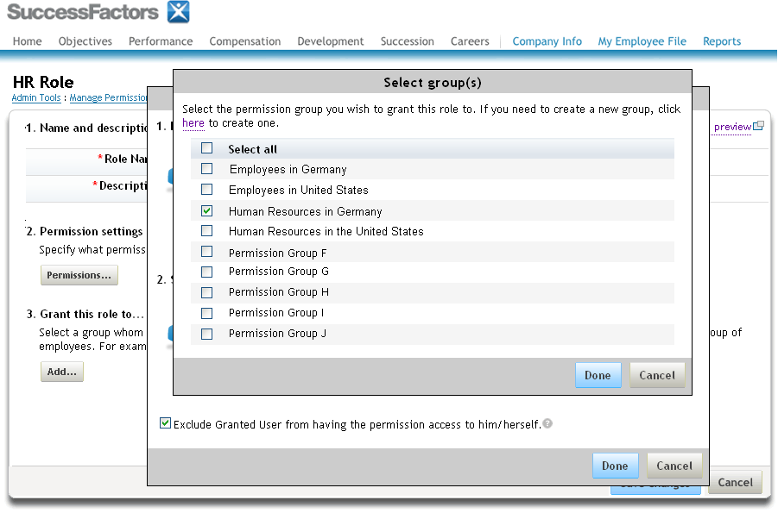
Select Groups
Notes:
Grant the role to “Human Resources in Germany”

Slide 50
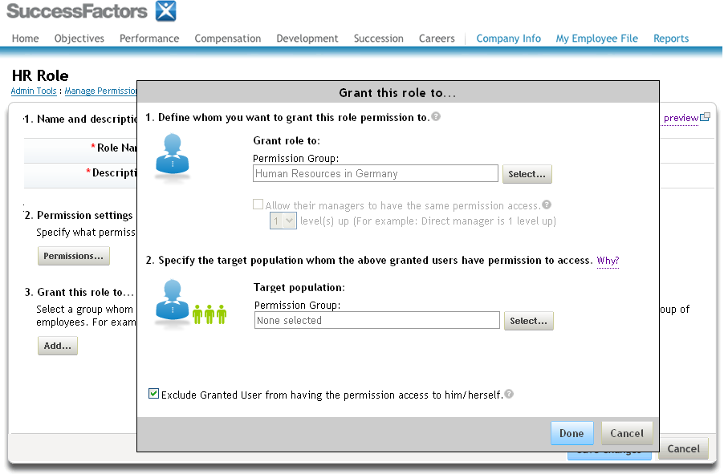
Grant Role
Granted Group
is shown
Now Select Target Group
Notes:
Grant the role to “Human Resources in Germany”

Slide 51
Select Groups
Notes:
Select group “Employees in Germany” for the target population

Slide 52
Select Groups
Target Group
is shown
Select “Done”
Notes:
Grant the role to “Human Resources in Germany”

Slide 53
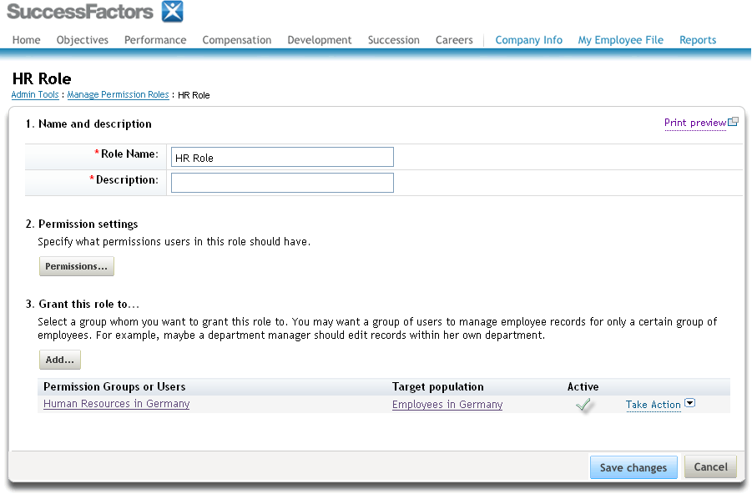
Granting Role to Users
Notes:
Here under step 3 we see a summary of the groups that you have granted to this role.

Slide 54
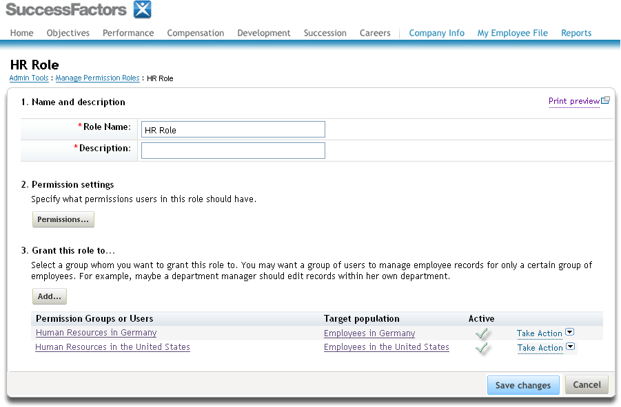
Granting Role to Users
Notes:
We can grant this role to multiple groups. Assume we granted this role to “Human Resources in the United States” with a target population of “Employees in the United States”. A new row appears in the list of Granted Groups.
We are now done with the final step, step 3.

Slide 55
Granting Role to Users
Granted
Users
Target
Users
Role
Notes:
In terms of the conceptual model, the Access Groups are on the left,
and the Target Groups are on the right.
We can continue to grant this role to many groups by selecting “Add” button again under step 3.

Slide 56
Granting Role to Users
Granted Users
Permission Role
Target Users
USA
HR
USA
Employees
HR Role
DEU
HR
DEU
Employees
HR Role
Notes:
In terms of the conceptual model, the Access Groups are on the left,
and the Target Groups are on the right.
We can continue to grant this role to many groups by selecting “Add” button again under step 3.

Slide 57
FAQ
What fields can be used to define groups?
All Standard Elements in the Data Model
Standard elements are user attributes like username, Department, Division, Location, and the standard CUSTOM01-15 filters
In addition to standard elements, groups can be defined through relationships like the Manager, Matrix Manager, HR Manager, Custom Manager and Second Manager.
Example
Grant Group = “All Managers in USA”
Target Group = “Direct Reports, All Levels”
Can a group contain named users?
Yes. Username is one of the fields allowed in a group.

Slide 58
Migrating Existing Customers
No automated migration, this is a new configuration. The current permissions system does not translate to the new system
Requires significant configuration and testing effort
Example Configuration Process for Existing Customers
Export current configuration through Security Permission Reports
Admin Tools → Manage Security → Security Permission Reports
Export Employee Files permissions in Succession Data Model
Plan out your roles and groups in the new system
Enable Role Based Security in a test system
Create the roles and groups.
Review role and group configurations (view or print the definitions)
Test each role and group access
Log in as a user in each group.
Test access to each permission granted.
Export Role Based Security configurations from your test system
Import Role Based Security configurations to your production system
Test again

Slide 59
Execution is the difference.

